Slide 1
HOSPITAL FINDER
PIP2001 Capstone Project
Review-3
Batch Number:CBD-10
ROLL NO | NAME
20211CBD0059 | Mahesh Reddy
20211CBD0018 | Vadde Vinod
20211CBD0051 | Mahammad Thouheed
20211CBD0010 | Mahammad Ajar
Under the Supervision of,
DR. SRINIVASAN T R,
Professor,
School of Computer Science and Engineering,
Presidency University.
Name of the Program: B.TECH
Name of the HoD: DR. PRAVINTHRAJA
Name of the Program Project Coordinator: MS. SUMA NG
Name of the School Project Coordinators: Dr. Sampath A K / Dr. Abdul Khadar A / Mr. Md Ziaur Rahman

Slide 2
CONTENT
INTRODUCTION
Literature Review
Existing method Drawback
Proposed Method
Objectives
Methodology/Modules
Architecture
Hardware/software components

Slide 3
Timeline of Project
Expected Outcomes
Conclusion
Github link
References
Project work mapping with SDG

Slide 4
PROBLEM STATEMENT
Build an android application that builds a communication gap between the hospitals and patients during emergencies. Build an android application that will display the nearest hospital and router to the selected hospital. After reaching the hospital, in some cases, patients are informed due to a lack of ventilators the patient cannot be admitted. So, the patient's family rushes toward another hospital. In this process, many patients lose their lives. To reduce this hassle our application displays all the available doctors in the hospitals. It displays the number of available resources like number of beds, number of ventilators, and number of available staff. Book an ambulance to the nearest hospital in one click.

Slide 5
Introduction
In the state of mind that a common person is in during a medical emergency, it becomes difficult to take calculated decisions such as which hospital to rush to. This lapse of decision could mean the difference between life or death for a loved one. Additionally, there are several aspects to consider such as availability of the required medical facilities, medicines, blood group and specialists to provide the patient with a maximum chance of survival in those crucial moments. Our app aims to be the solution, giving the user all the necessary information during a medical emergency taking into account their location and requirements and providing the best-suited hospital in that hour of need.

Slide 6
Literature Review
1.Frost & Sullivan (2017) - prevent medical accidents in advance by using an integrated solution based on information and communication.
2• Karen Taylor (2017) - improving treatment procedures for existing patients and introducing new functions.
3 • European Union Agency for Network and Information Security (2016) - A hospital that improves the patient treatment process based on IoT.
4• Korea Embedded Software and System Industry Association (2018)
5 • Seoul Asan Hospital Innovation Design Center (2020) - A next-generation hospital that exceeds the limits of existing hospitals in terms of quality of care.
6 • Ministry of Health and Welfare (2020) - provides medical services by applying ICT such as 5G and IoT to improve medical services such as enhancing patient safety.

Slide 7
Existing method Drawback
ADVANTAGES:
Improved efficiency and speed – The healthcare apps can enhance healthcare delivery with more efficiency, as they can handle multiple queries and requirements at a time.
Reduction in healthcare costs – The cost associated with the healthcare consultation reduced significantly with the usage of apps as the maintenance cost is less.
Easier and convenient to use – The healthcare apps can be accessed at any time of the day. They have a 24/7 patient monitoring system.
Save time – With the healthcare apps, the patients can easily connect with the healthcare provider for consultation. It saves traveling time between home and the healthcare center and also requires fewer visits as compared to the traditional approach.
Seamless exchange of data – The healthcare apps come with an inbuilt option to share and transfer the health data across the healthcare system.

Slide 8
Existing method Drawback
DISADVANTAGES:
Data Privacy – The health apps continuously collect and analyze the health data of the person. The threat to the exposure of personal information by the hacker and sharing with the third parties is a major concern
Accuracy of Data – The information and advice provided by healthcare apps is also an important concern with healthcare apps.
Internet accessibility, the high cost of smartphones, lack of regulatory approval, high cost for in-purchase applications are some of the other key factors hampering penetration of the mobile health apps in the market, faltering their demand.

Slide 9
Proposed Method
User interface
Design an intuitive interface with search bars, filters, and interactive maps. Use a consistent design language across platforms.
Communication
Establish secure communication channels between the frontend and backend components. Use RESTful APIs or GraphQL for data retrieval and manipulation.
GPS
Use the global positioning system (GPS) on smartphones to calculate the nearest hospitals and provide directions.
Hospital demographics
Include hospital demographics, inpatient procedure rates, outpatient calls, hospital quality data, and clinical trials data

Slide 10
Objectives
User-Friendly Interface: • Objective: Design and develop an intuitive and user-friendly interface that allows users to easily navigate and search for hospitals.
2. Accurate Hospital Data: • Objective: Ensure that the app provides up-to-date and accurate information about hospitals, including their locations, contact details, services offered, and any other relevant data. 3. Geolocation Services: • Objective: Implement geolocation features to enable users to find nearby hospitals based on their current location.

Slide 11
Objectives
4. Search and Filtering Options: • Objective: Provide users with robust search and filtering options to refine their hospital search based on criteria such as specialty,facilities, ratings, and distance.
5. Integration with Emergency Services: • Objective: Integrate emergency service information, such as contact numbers and emergency room wait times, to enhance the app’s usefulness during critical situations.International Journal of Research Publication and Reviews, Vol 5, no 1, pp 1904-1910 January 2024 1906.
6. User Reviews and Ratings: • Objective: Enable users to leave reviews and ratings for hospitals, fostering a community-driven feedback system.

Slide 12
Methodology/Modules
MODULES Registration: process of signing up or enrolling in the app. During the registration process, users typically provide necessary information, such as their email address, username, password, and sometime additional details depending on the platform's requirements.
Login: it allows the user to log in by using a username and password. Login is the process by which users access an application, website, or service using their previously created credentials, typically a combination of a username and password.
Treatment for the Disease required: search for the treatment specialist for the required disease. Start by understanding the nature of the disease or medical condition you are dealing with.

Slide 13
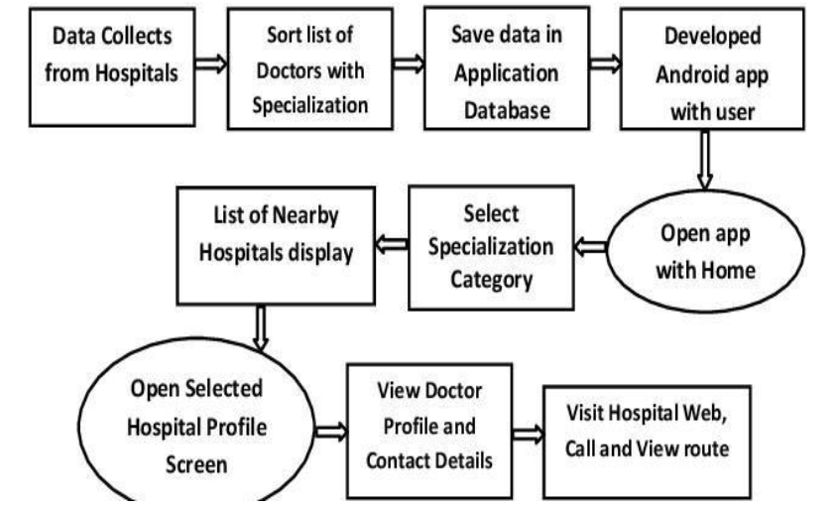
Architecture

Slide 14
Hardware/software components
Software Requirements:
Android Studio
HTML & HTML5
CSS
Google Maps API
Node.js

Slide 15
Timeline of Project
Research and Analysis: September 2024 -October 2024
Development of App(Frontend&Backend): October 2024 - November 2024
Testing and Refinement: November 2024
Final Report and Presentation: December 2024
( it will take around 3 to 4 months)

Slide 16
Expected Outcomes
1. Improved Healthcare Accessibility
Quick and Easy Access: Users can locate hospitals, clinics, or specialized healthcare facilities near them based on their current location or specified preferences.
24/7 Availability: A hospital finder app can provide continuous access to healthcare facility information, allowing users to find hospitals at any time, including during emergencies.
2. Real-Time Information
Live Hospital Status: The app could provide real-time data about hospital availability, including information such as:
Bed occupancy
Emergency room wait times
Specialized equipment or doctors available (e.g., MRI, cardiologists)
Reduced Overcrowding: By providing real-time information on hospital capacity, the app can direct users to less crowded hospitals, reducing the strain on busy healthcare facilities.

Slide 17
Expected Outcomes
3. Optimized Emergency Response
Reduced Response Time: In emergency situations, users can quickly find the nearest hospital with emergency services, reducing the time spent searching for appropriate care.
Integration with Ambulance Services: The app can integrate with local emergency services to send location-based alerts, or dispatch an ambulance, further optimizing the response process.
4. Better Resource Management for Hospitals
Efficient Patient Distribution: Hospitals can manage incoming patient flow more effectively by sharing real-time capacity information, reducing bottlenecks in emergency rooms and overcrowding.
Data-Driven Insights: Hospitals can leverage user data for better resource allocation and to identify trends in patient needs (e.g., higher demand for certain specialists or services).

Slide 18
Conclusion
A hospital finder app holds immense potential to revolutionize healthcare accessibility by bridging the gap between patients and medical facilities. Its core benefits include providing users with quick and easy access to nearby hospitals, real-time information on hospital capacity and services, and optimized emergency responses. By integrating location-based services, real-time data, and personalized recommendations, the app enhances decision-making for patients, leading to faster and more efficient access to care, especially in emergency situations.
Moreover, hospitals benefit from better resource management, as real-time capacity updates help balance patient flow and prevent overcrowding. The app fosters transparency through patient reviews and ratings, empowering users to make informed healthcare choices. Integrations with telemedicine services, ambulance dispatch, and preventive care alerts further extend the app's utility, making it a comprehensive tool for both routine healthcare needs and urgent care situations.

Slide 19
Github Link
The Github link provided should have public access permission.
Github Link: https://github.com/Mahesh-219/hopsitalfinder

Slide 20
References
1.Agarwal, S., & LeFevre, A. E. (2017). Finding healthcare at your fingertips: A case study of apps addressing healthcare needs in India. In Proceedings of the Ninth International Conference on Information and Communication Technologies and Development (ICTD).
2. Hossain, M. S., & Ahmed, K. (2019). Telemedicine system using Hospital Finder app. In 2019 3rd International Conference on Electrical, Computer & Telecommunication Engineering (ICECTE).
3. Mehta, N., Pandit, A., & Shukla, S. (2016). Hospital Finder mobile applications: a systematic review. International Journal of Pharmacy & Technology, 8(3), 16065-16073.
4. National Institute of Standards and Technology (NIST). (2020). Digital Identity Guidelines: Authentication and Lifecycle Management. Retrieved from https://nvlpubs.nist.gov/nistpubs/SpecialPublications/NIST.SP.800-63b.pdf
5. Llorens-Montes, F. J., Ruiz-Moreno, A., & del Barrio-García, S. (2015). Hospital Finder applications and service quality: Influencing patient loyalty and recommendation. Computers in Human Behavior, 48, 542-549
https://www.indeed.com/career-advice/career-development/how-to-cite-a-research-paper

Slide 21

Project work mapping with SDG

Slide 22
Sustainable development goals of hospital finder: Explanation: Creating a web app focused on hospital finder aligns with several Sustainable Development Goals (SDGs). However, it's important to note that directly copying or paraphrasing content without proper citation is considered plagiarism. Here's a list of potential SDGs related to a hospital finder web app, along with brief explanations to help you develop your content while avoiding plagiarism.
Good Health and Well-being (SDG 3): Explanation: The primary goal of a hospital finder app is to contribute to improving access to healthcare services, ensuring good health and well-being for individuals.
Industry, Innovation, and Infrastructure (SDG 9): Explanation: Developing a technology-based solution like a hospital finder app involves innovation in healthcare infrastructure, contributing to sustainable development.
Reduced Inequality (SDG 10): Explanation: By facilitating equal access to healthcare services through the app, you can contribute to reducing inequalities in health outcomes across different socio-economic groups.
Partnerships for the Goals (SDG 17): Explanation: Collaborating with healthcare providers, governmental bodies, and NGOs is crucial for the success of the hospital finder app, promoting partnerships to achieve sustainable development goals.

Slide 23
Life on Land (SDG 15): Explanation: Ensuring access to healthcare services, especially in rural or remote areas, contributes to sustainable development by promoting the well-being of communities and the ecosystems they are part of.
Responsible Consumption and Production (SDG 12): Explanation: Developing a hospital finder app involves considering sustainable practices in software development, contributing to responsible consumption and production. When incorporating these SDGs into your content, make sure to express the ideas in your own words and provide proper citations if you use specific information or statistics. This helps you avoid plagiarism and ensures the content is original and accurate.

Slide 24
Thank You

